Slide 1
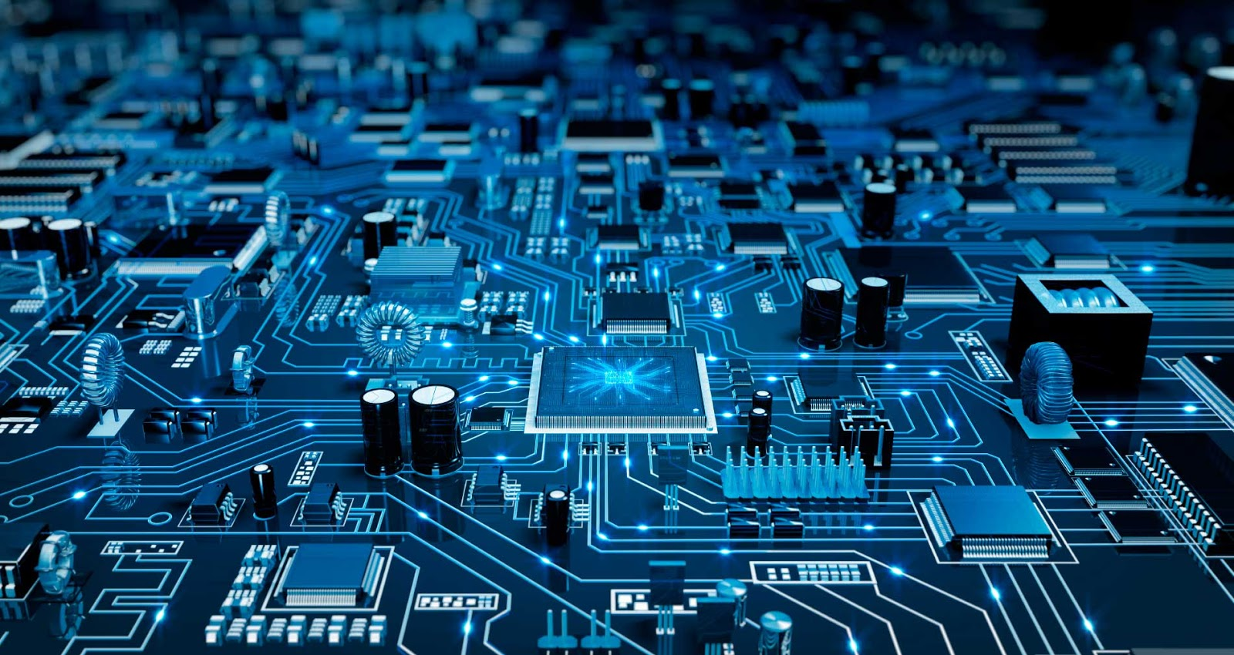

Parallel and Distributed Systems / 5
Pavel Krömer, Dept. of Computer Science, VSB – Technical University of Ostrava

Slide 2
Agenda
Parallel systems with distributed memory
Computer clusters and HPC
Literature
C. S. R. PRABHU: GRID AND CLUSTER COMPUTING. PHI Learning Pvt. Ltd., 2008

Slide 3
Distributed memory systems
Notes:
what do we associate with digital transformation/DSM?
Is that all new? Is this change the first?

Slide 4
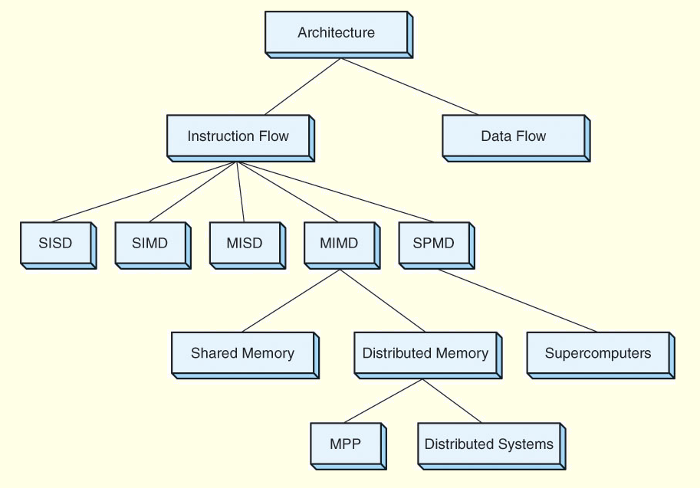

Slide 5
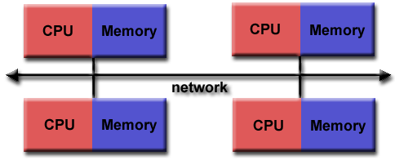
Distributed memory systems
Use a communication network to connect inter-processor memory.
Processors have own local memory and memory addresses in one processor do not map to another processor. No global address space exists.
Processors operate independently, local changes do not affect other processors (and their memory). Cache coherency out of question.
IPC (data sharing + synchronization) explicitly defined by program/programmer.
Also loosely coupled systems

Slide 6
Distributed memory systems
Challenging IPC
Explicit IPC via message passing
Communication usually a significant bottleneck
Communication-driven algorithm design and considerations
Advantages
Memory scalable with the number of processors
Each processor can rapidly access its own memory without interference and without any special overhead wrt. cache coherency
Cost effective, can use commodity, off-the-shelf processors and networking

Slide 7
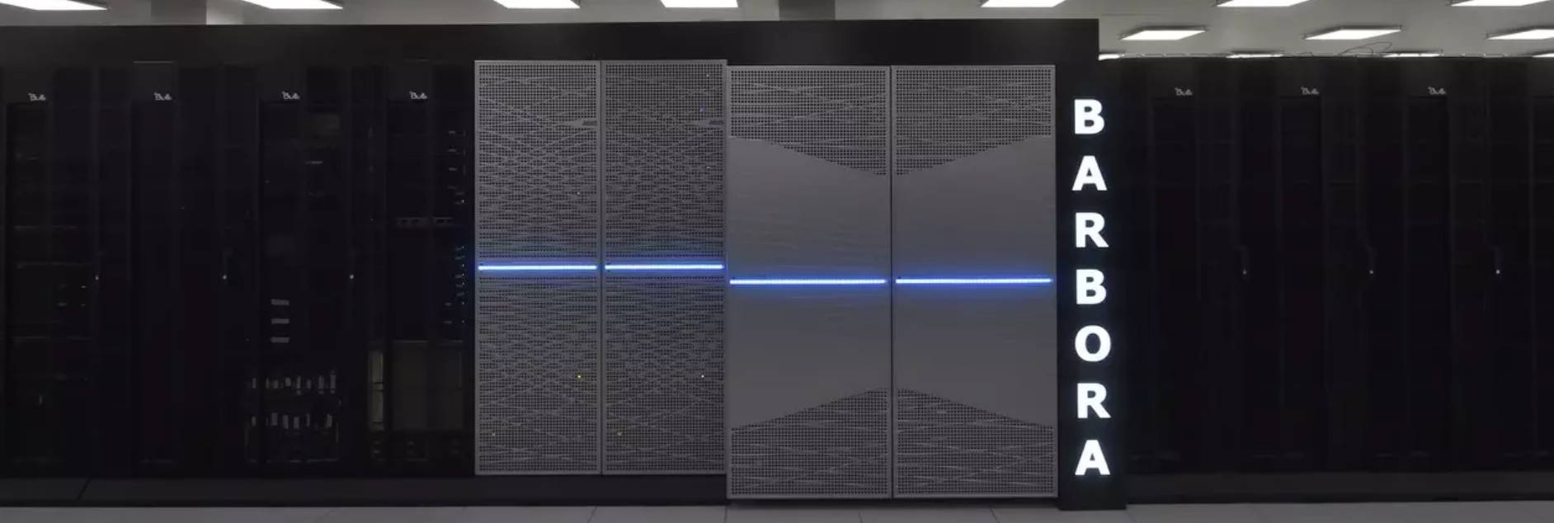
Distributed memory systems
Disadvantages
Program/programmer responsible for all details associated with data communication between processors
Difficult mapping of existing data structures to distributed memory for an efficient execution
Non-uniform memory access times - data residing on a remote node takes longer to access than local data
Barbora - 2. 10. 2019, VSB-TUO / IT4Innovations - 192x compute node w. 18-core CPU, 192 GiB RAM
- 8x GPU node w. 12-core CPU, 192 GiB RAM, 4x NVIDIA V100
- 1x fat node w. 8x16-core CPU, 6 TiB RAM

Slide 8
Anatomy of a computer cluster
Notes:
what do we associate with digital transformation/DSM?
Is that all new? Is this change the first?

Slide 9
Computer cluster
A computer cluster is a set of interconnected computers (compute nodes) that work together as if they were a single orchestrated resource.
Each node has its own OS and software stack and the cluster operation is achieved through additional software (middleware, communication, scheduling, etc.)

Slide 10
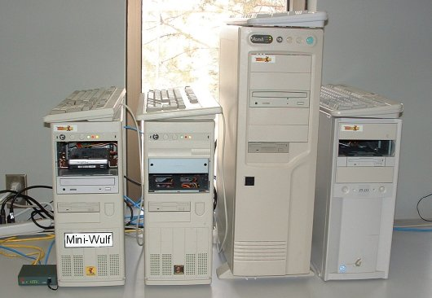
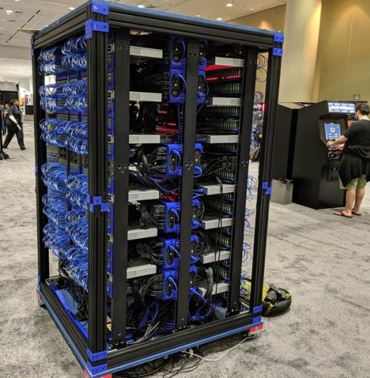
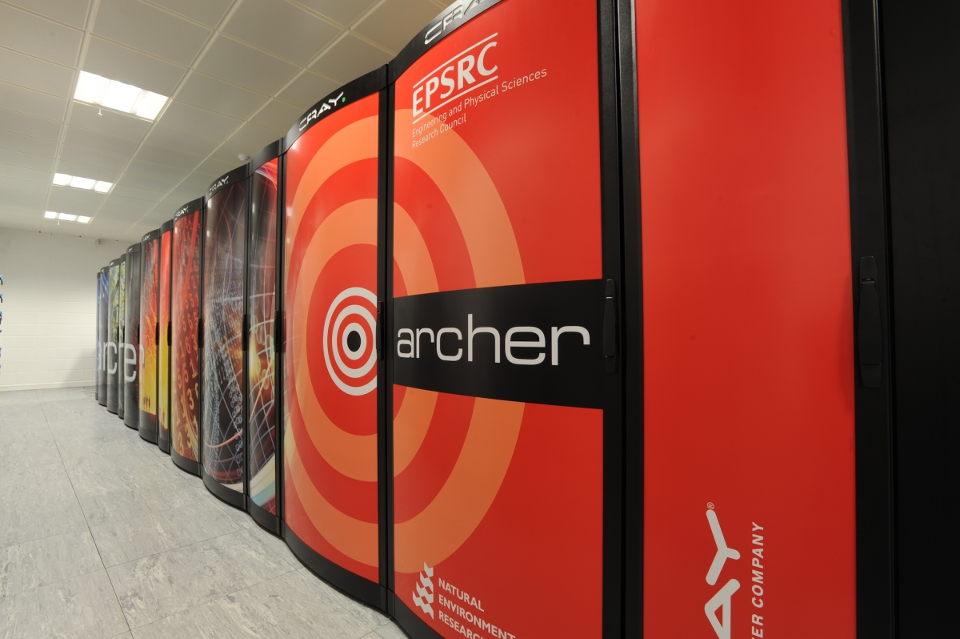
Computer cluster
A very broad category
Mini-Wulf – 6x PC w. FreeBSD
1024xRPi - RasPi Supercomp
Archer – A UK National Resource Cray XC30
Notes:
- Oracle OpenWorld conference, 09/2019
--- According to Oracle, the computer includes 49 3D-printed Raspberry Pi holders, five racks, 22 network switches, 18 USB power supplies, a whole lot of network and power cables, and 1024 Raspberry Pis in a box inspired by a certain British Police Box that may or may not be bigger on the inside.
- ARCHER (Advanced Research Computing High End Resource), UK National Supercomputer

Slide 11
Computer cluster
A set of loosely or tightly connected compute nodes that work together so that, in many respects, they can be viewed as a single system.
Each node (usually) performs the same task and is controlled by a software scheduler. They operate in a non-interactive (batch) manner
They (usually) use high-performance networking hardware interconnect networks). - 100 Gb Ethernet - Fiber Channel Standard (FCS) - Myrinet (past) - Infiniband

Slide 12
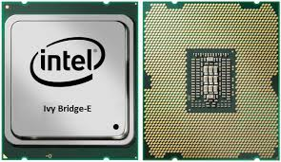
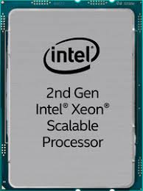
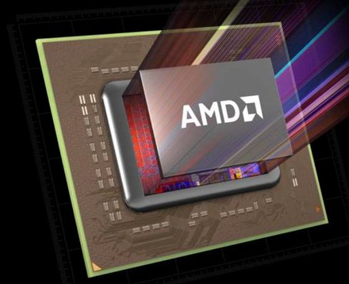
Compute node(s)
Archer
two 2.7 GHz, 12-core E5-2697 v2 (Ivy Bridge) series processors
64/128 GB of memory (NUMA wrt. the processors)
4544 standard memory nodes (12 groups, 109,056 cores) and 376 high memory nodes (1 group, 9,024 cores)
Aries interconnect
Barbora
192x compute node w. 18-core CPU, 192 GiB RAM
8x GPU node w. 12-core CPU, 192 GiB RAM, 4x NVIDIA V100
1x fat node w. 8x16-core CPU, 6 TiB RAM
Mellanox InfiniBand HDR 200 Gbps network
Archer 2 (2020)
Newly contracted to Cray
11,696 AMD Epyc Rome CPUs / x 64 cores
total of 1.5m threads
Europe’s most powerful supercomputer

Slide 13
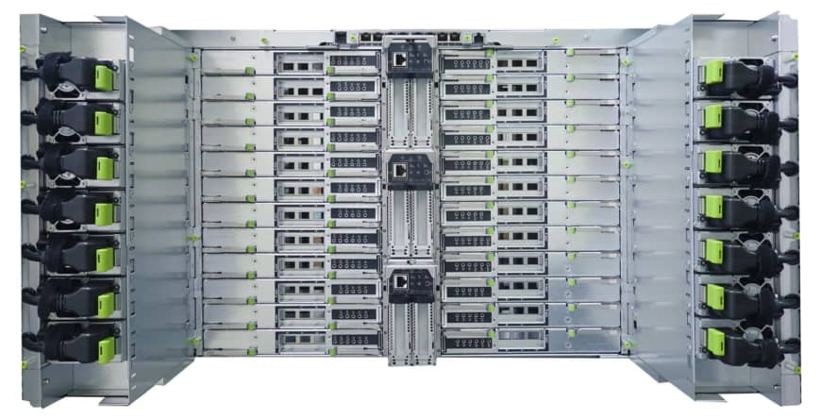
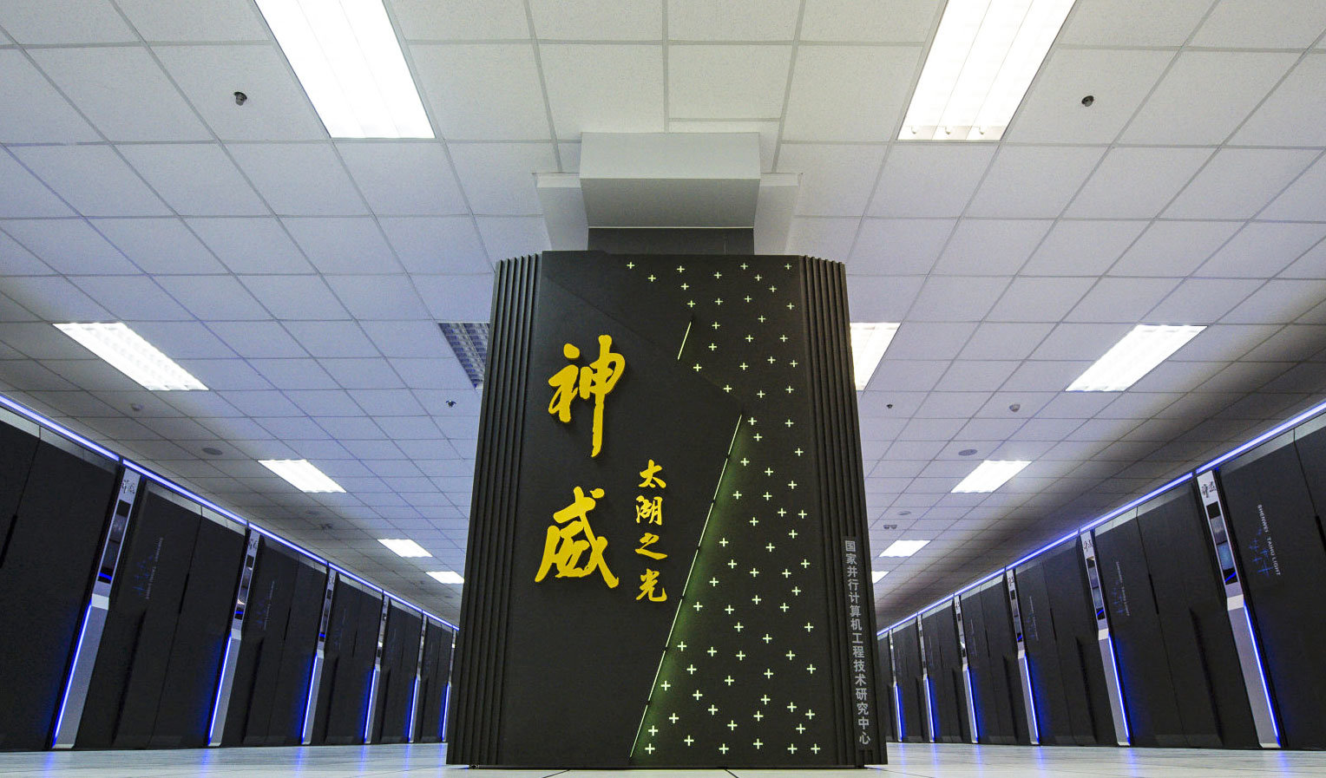
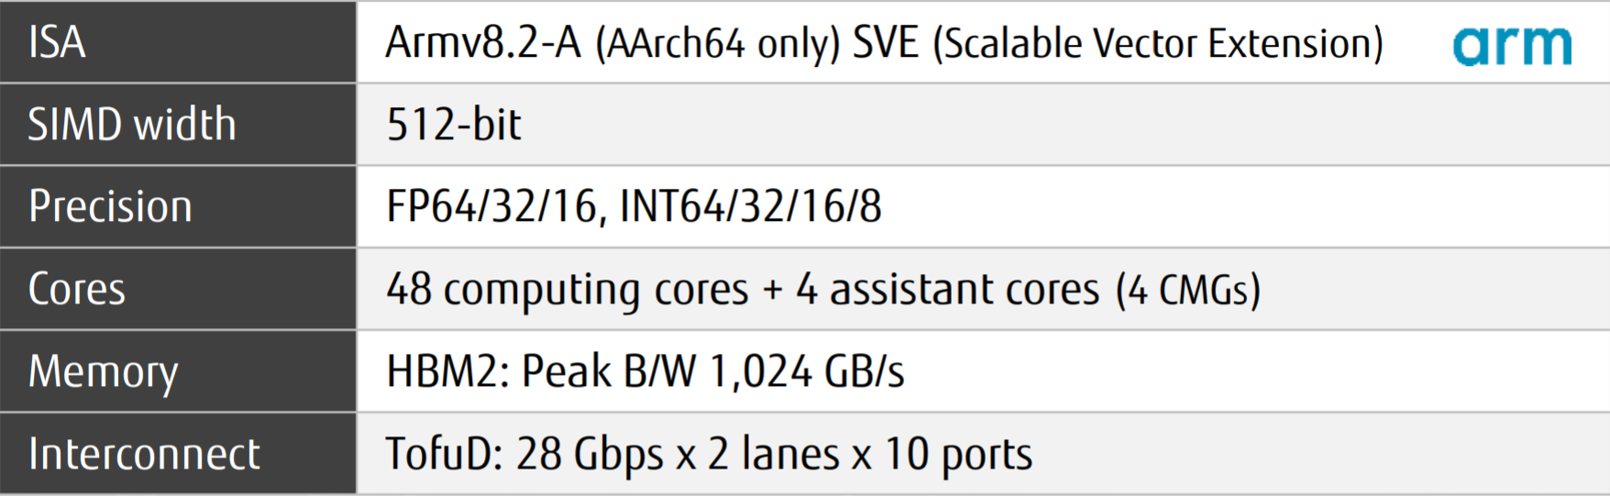
Compute node(s)
Sunway TaihuLight (2019: #3)
40,96 x 64-bit RISC processors (SW26010)
Sunway architecture (2006+, based on DEC Alpha)
Fugaku (2021)
48+2/4 ARM CPU by Fujitsu
Out-of-order execution
High-performance Arm8.2 CPU for HPC and AI

Slide 14
Interconnect networks
Notes:
what do we associate with digital transformation/DSM?
Is that all new? Is this change the first?

Slide 15
Interconnect networks
Communication backbone of distributed systems. Connect compute (and other) nodes and aim to minimize bottlenecks caused by communication.
static (direct, p2p) vs. dynamic (indirect, switching, routing)

